Slide 1
Selective Inhibition of Fungal IMPDH by a Novel Macrocyclic Peptide Targeting a Non-Canonical Allosteric Site
Qingan Sun¹, David Korasick¹, Yoann Huet¹, Joerg Freigang¹, Sasha Kweskin¹, Zhenzhen Qiao¹, Phillip Hussey¹, Jason Meyer¹, Rachel Baltz¹, Erina Nakajima², Naohiro Taniguchi², Takeshi Asakawa², Kyosuke Ueda², Makoto Jitsuoka², Takanori Aoki², Tatsuya Niimi², Yui Hirata², Junichi Nishikawa² and Patrick C. Reid²
29th Enzyme Mechanisms Conference
January 4-8, 2026
Omni La Costa, Carlsbad, CA
Bayer Crop Science
PeptiDream Inc.
Notes:
Good morning, everyone. It’s a privilege to introduce our research at Bayer in this session on Enzymes and Health. My name is Qingan Sun. I am a biophysicist from Bayer. At Bayer, our mission is ‘Health for all, hunger for none’—a vision that drives our efforts to improve both human and plant health through science and innovation.

Slide 2
CropKey: Unlock the future of crop protection
Notes:
One way we deliver on this mission is through CropKey, our target-first discovery platform. CropKey accelerates identification of novel modes of action and enables rational design of next-generation crop protection solutions. Let me share a short video to illustrate how CropKey works.

Slide 3
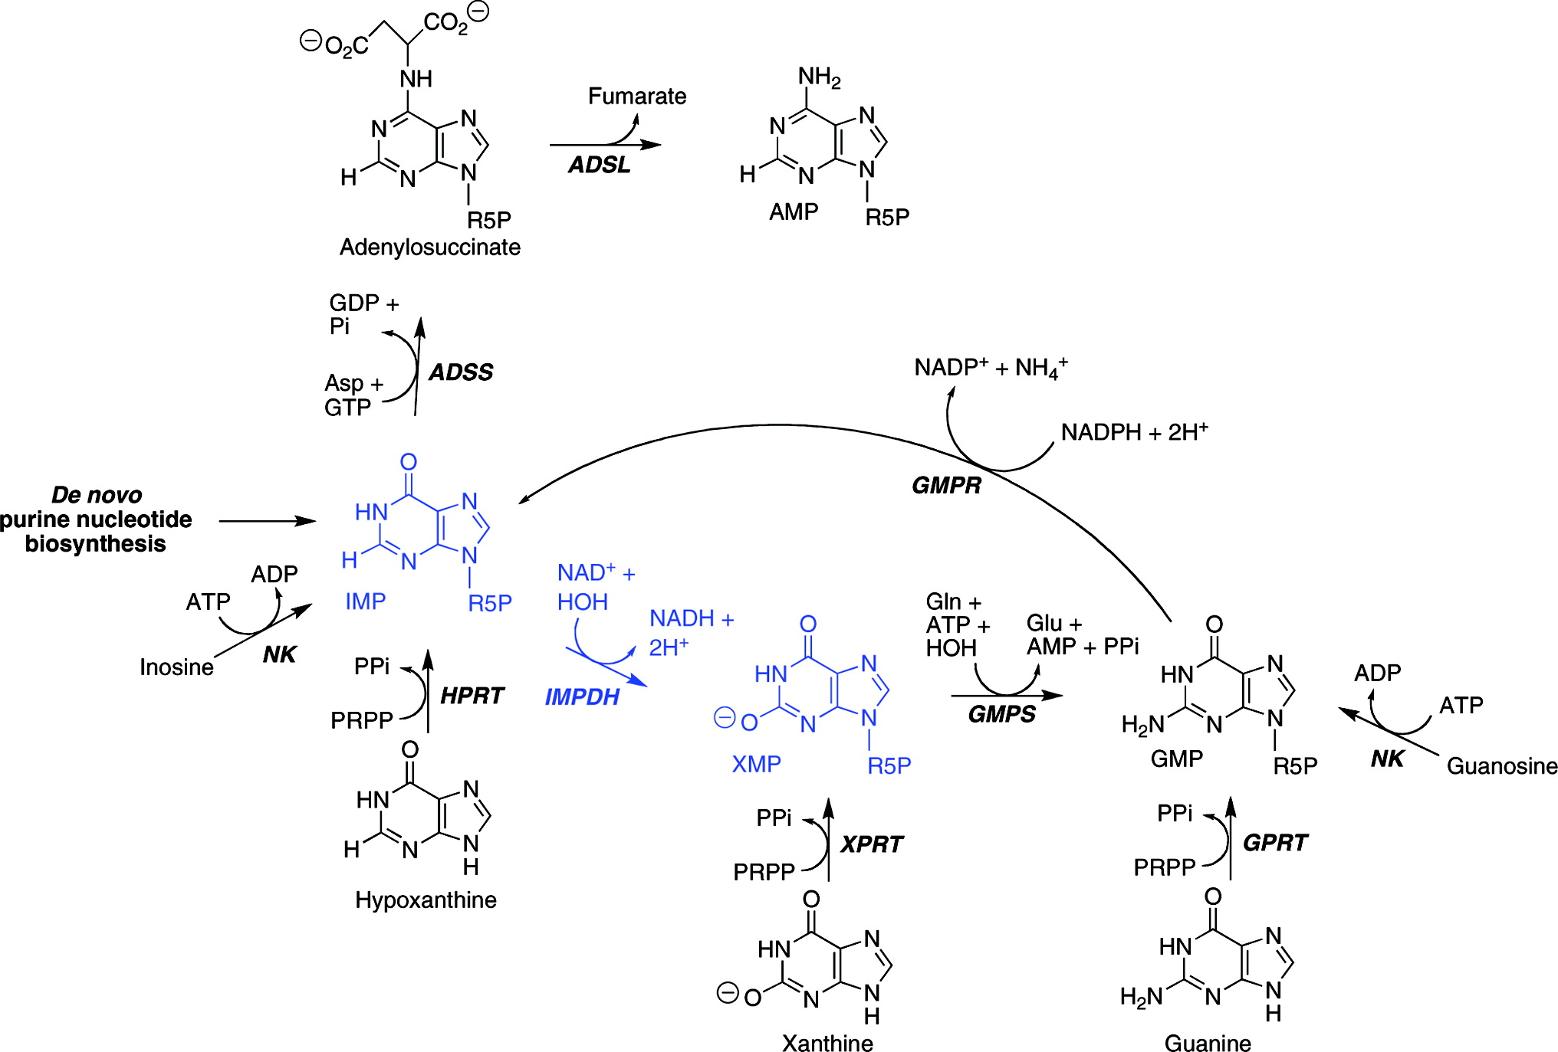
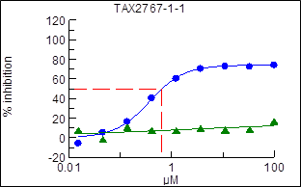
IMPDH: A Genetically and Chemically Validated Target in Fungi
Inosine-5′-Monophosphate Dehydrogenase: Rate-Limiting Step in de novo Guanine Nucleotide Biosynthesis
Growth Inhibition of Septoria tritici by Mycophenolic Acid
culture medium supplemented with 0.4 mM Guanosine (green) or NOT (blue).
IMP Dehydrogenase: Structure,
Mechanism, and Inhibition. Lizbeth Hedstrom. Chemical Reviews 2009 109 (7), 2903

Slide 4
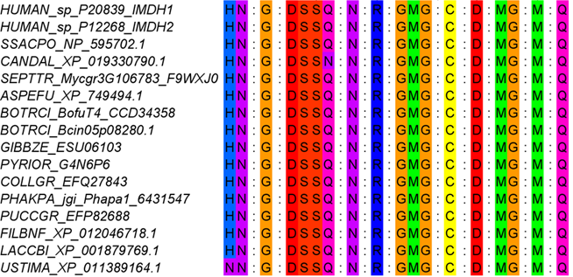
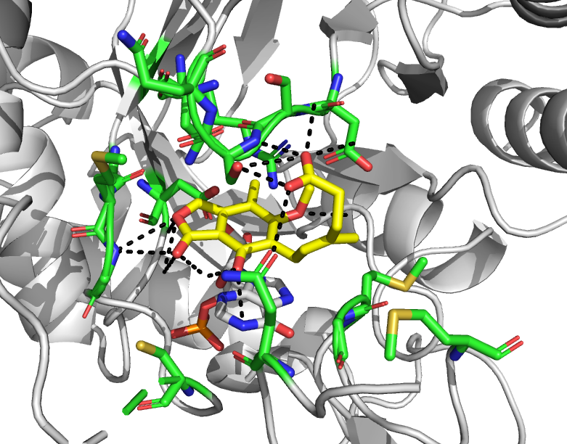




High Conservation of the Small Molecule Binding Site in IMPDHs
Sequence Alignment of Human and Fungal IMPDHs
Interaction between fungal IMPDH and small molecule inhibitor
Overall high conservation of the MPA binding site between human and fungi sequences (100% within 5A from MPA)
USTIMA IMPDH X-ray structure in complex with MPA (yellow carbons)
Residues within 5A from the MPA: green carbons

Slide 5
Peptide Modalities: An Emerging Technology for Crop Protection
Revival of essential targets (CropKey)
Potential disruptive technology (5%+ in Pharma 2022)
New target space (PPIs, glues, etc.)
WHY PEPTIDES?
“Favorable” safety profiles
Discover new MOA (novel epitopes)
Improved affinity & selectivity via “larger” epitopes, potency
Opportunities: build upon limited knowledgebase, screening tech., library design (wet lab/comp.), bioavailability, stability, synthesis/scale/COGs, Regulatory path uncertain

Slide 6
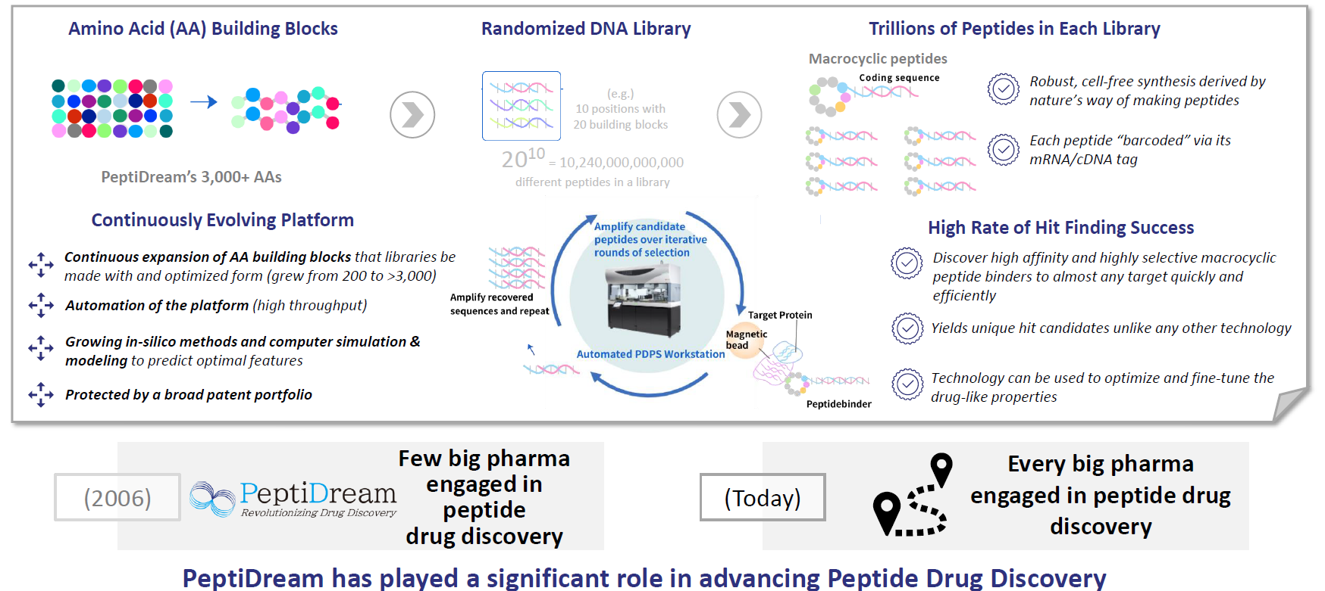
Bayer–PeptiDream: Peptide Exploration for Crop Protection
PeptiDream’s Evolving Proprietary PDPS® Drug Discovery Platform
Source: PeptiDream corporate website
Notes:
Peptide Discovery Platform System

Slide 7
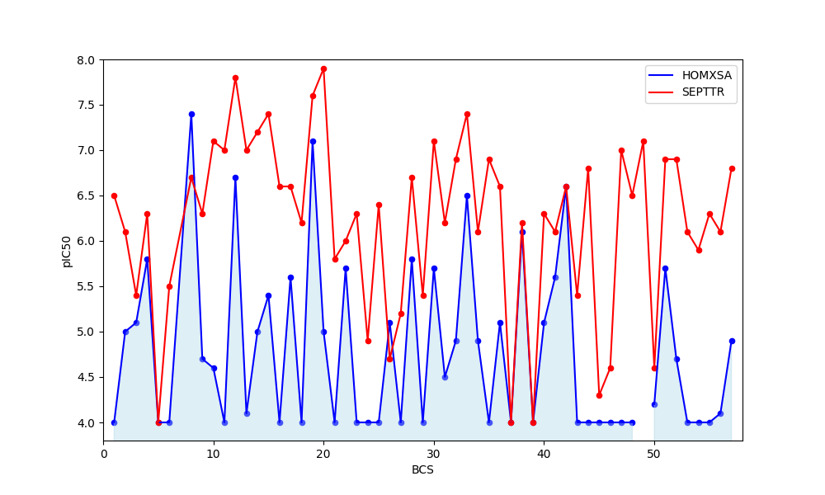
PeptiDream Hits: Potent and Selective Peptides
Differential IMPDH Inhibition: Fungal Target vs. Human Counterpart
Notes:
PD20: 1607
PD25: 1585

Slide 8
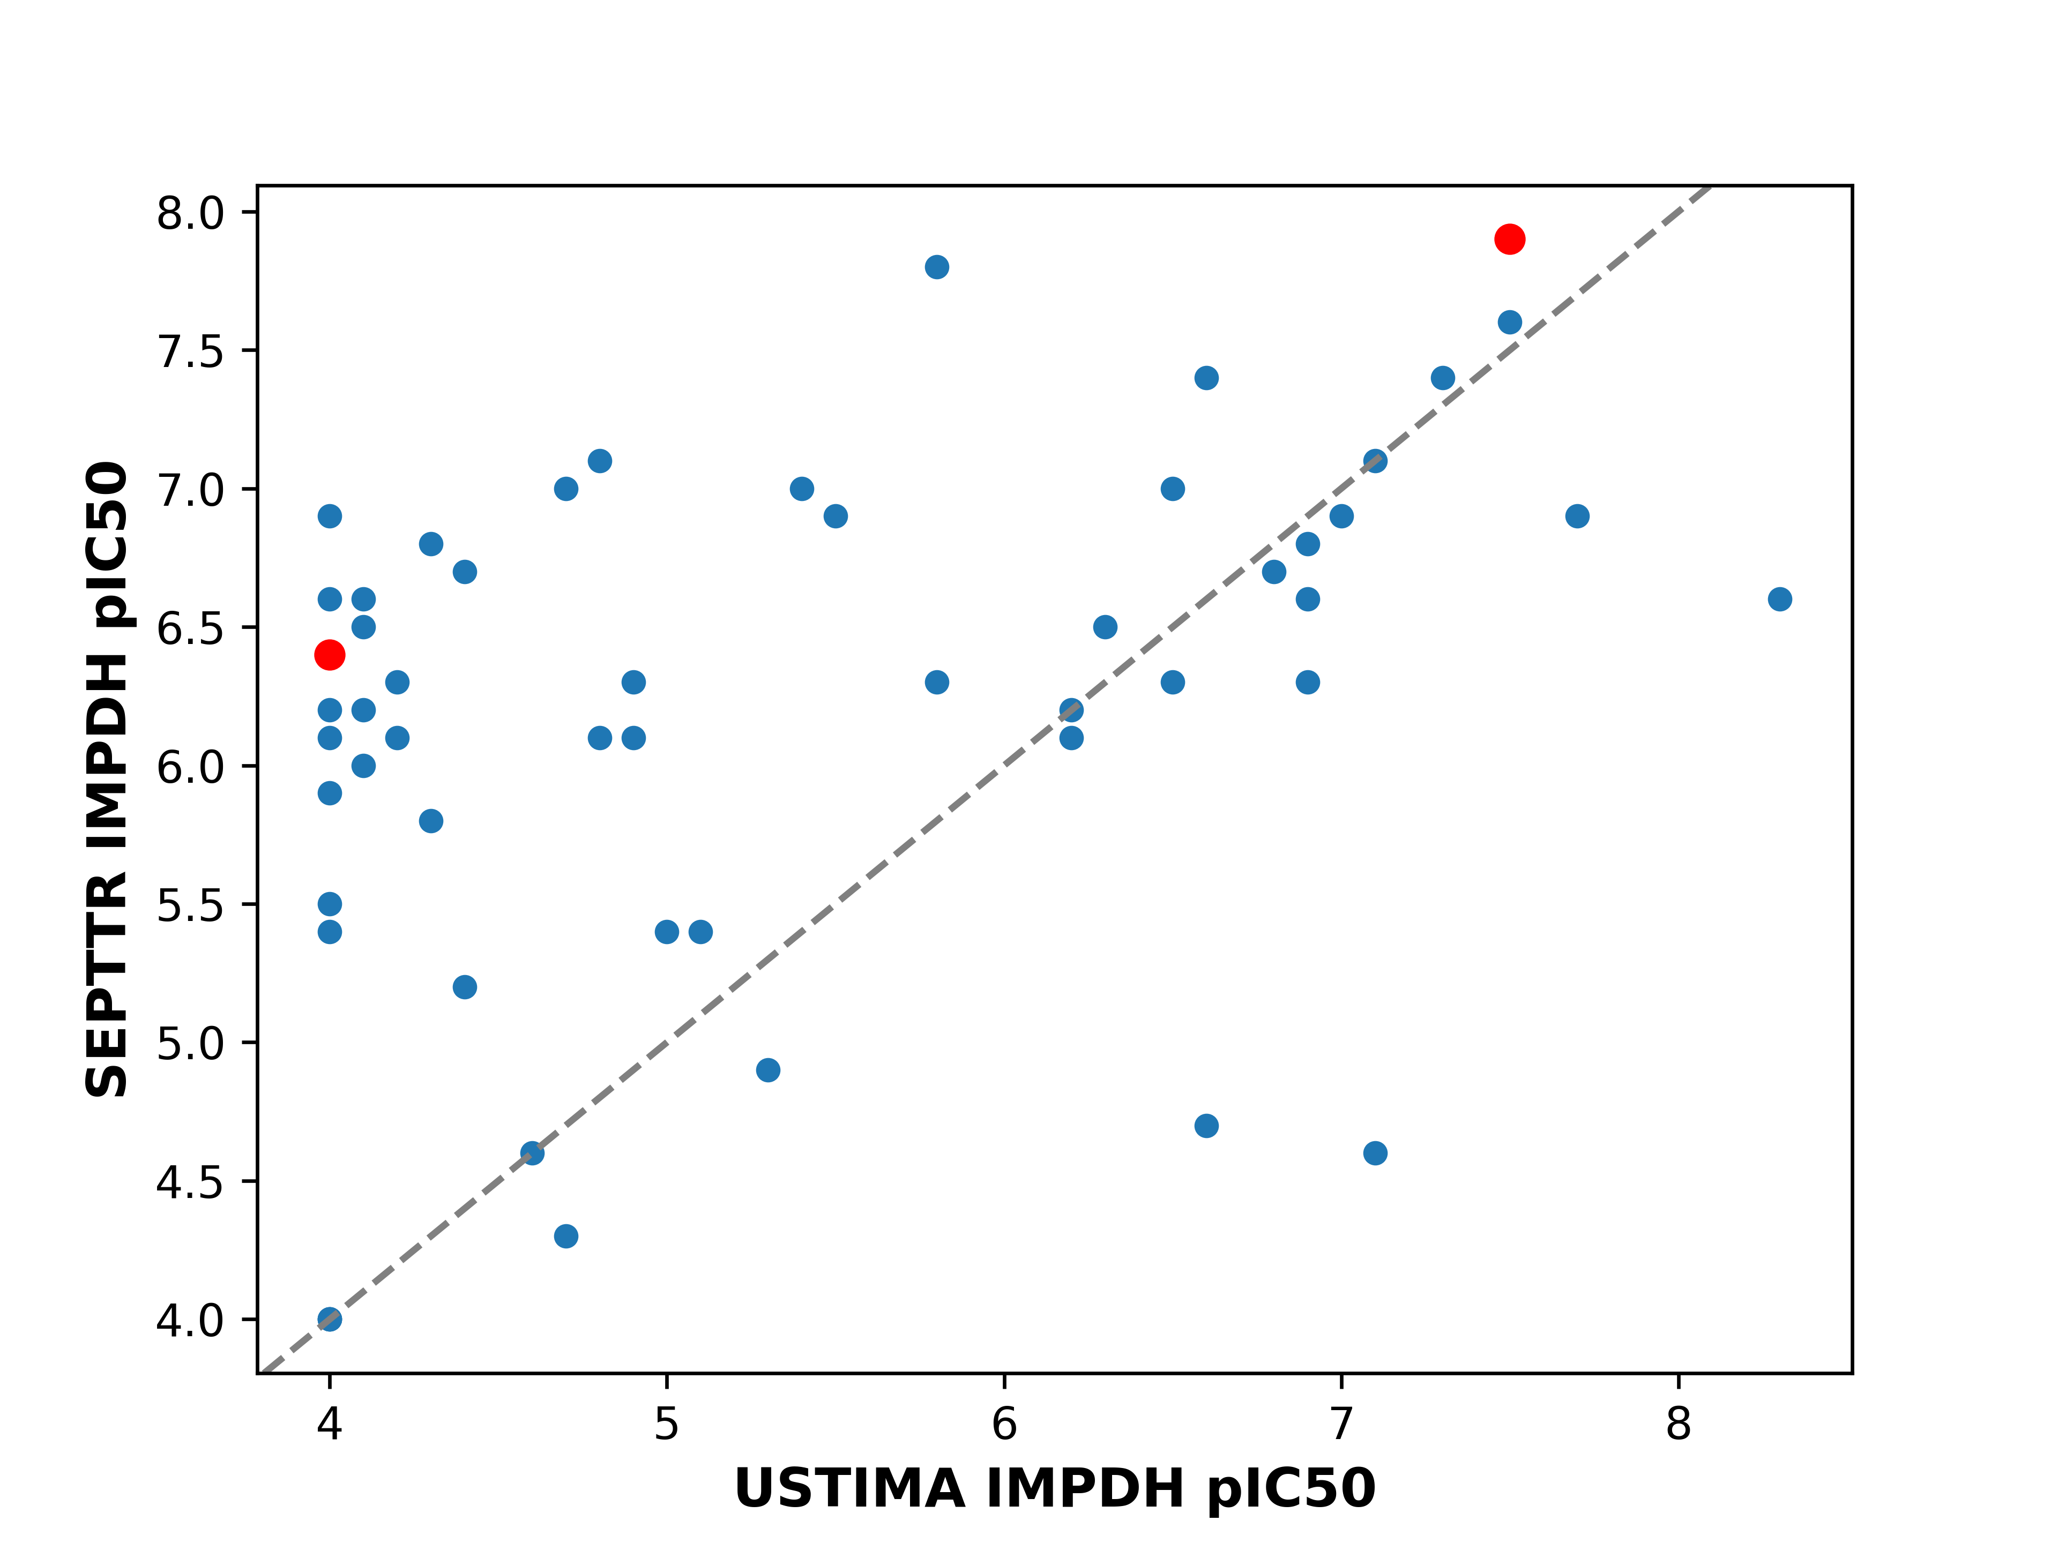
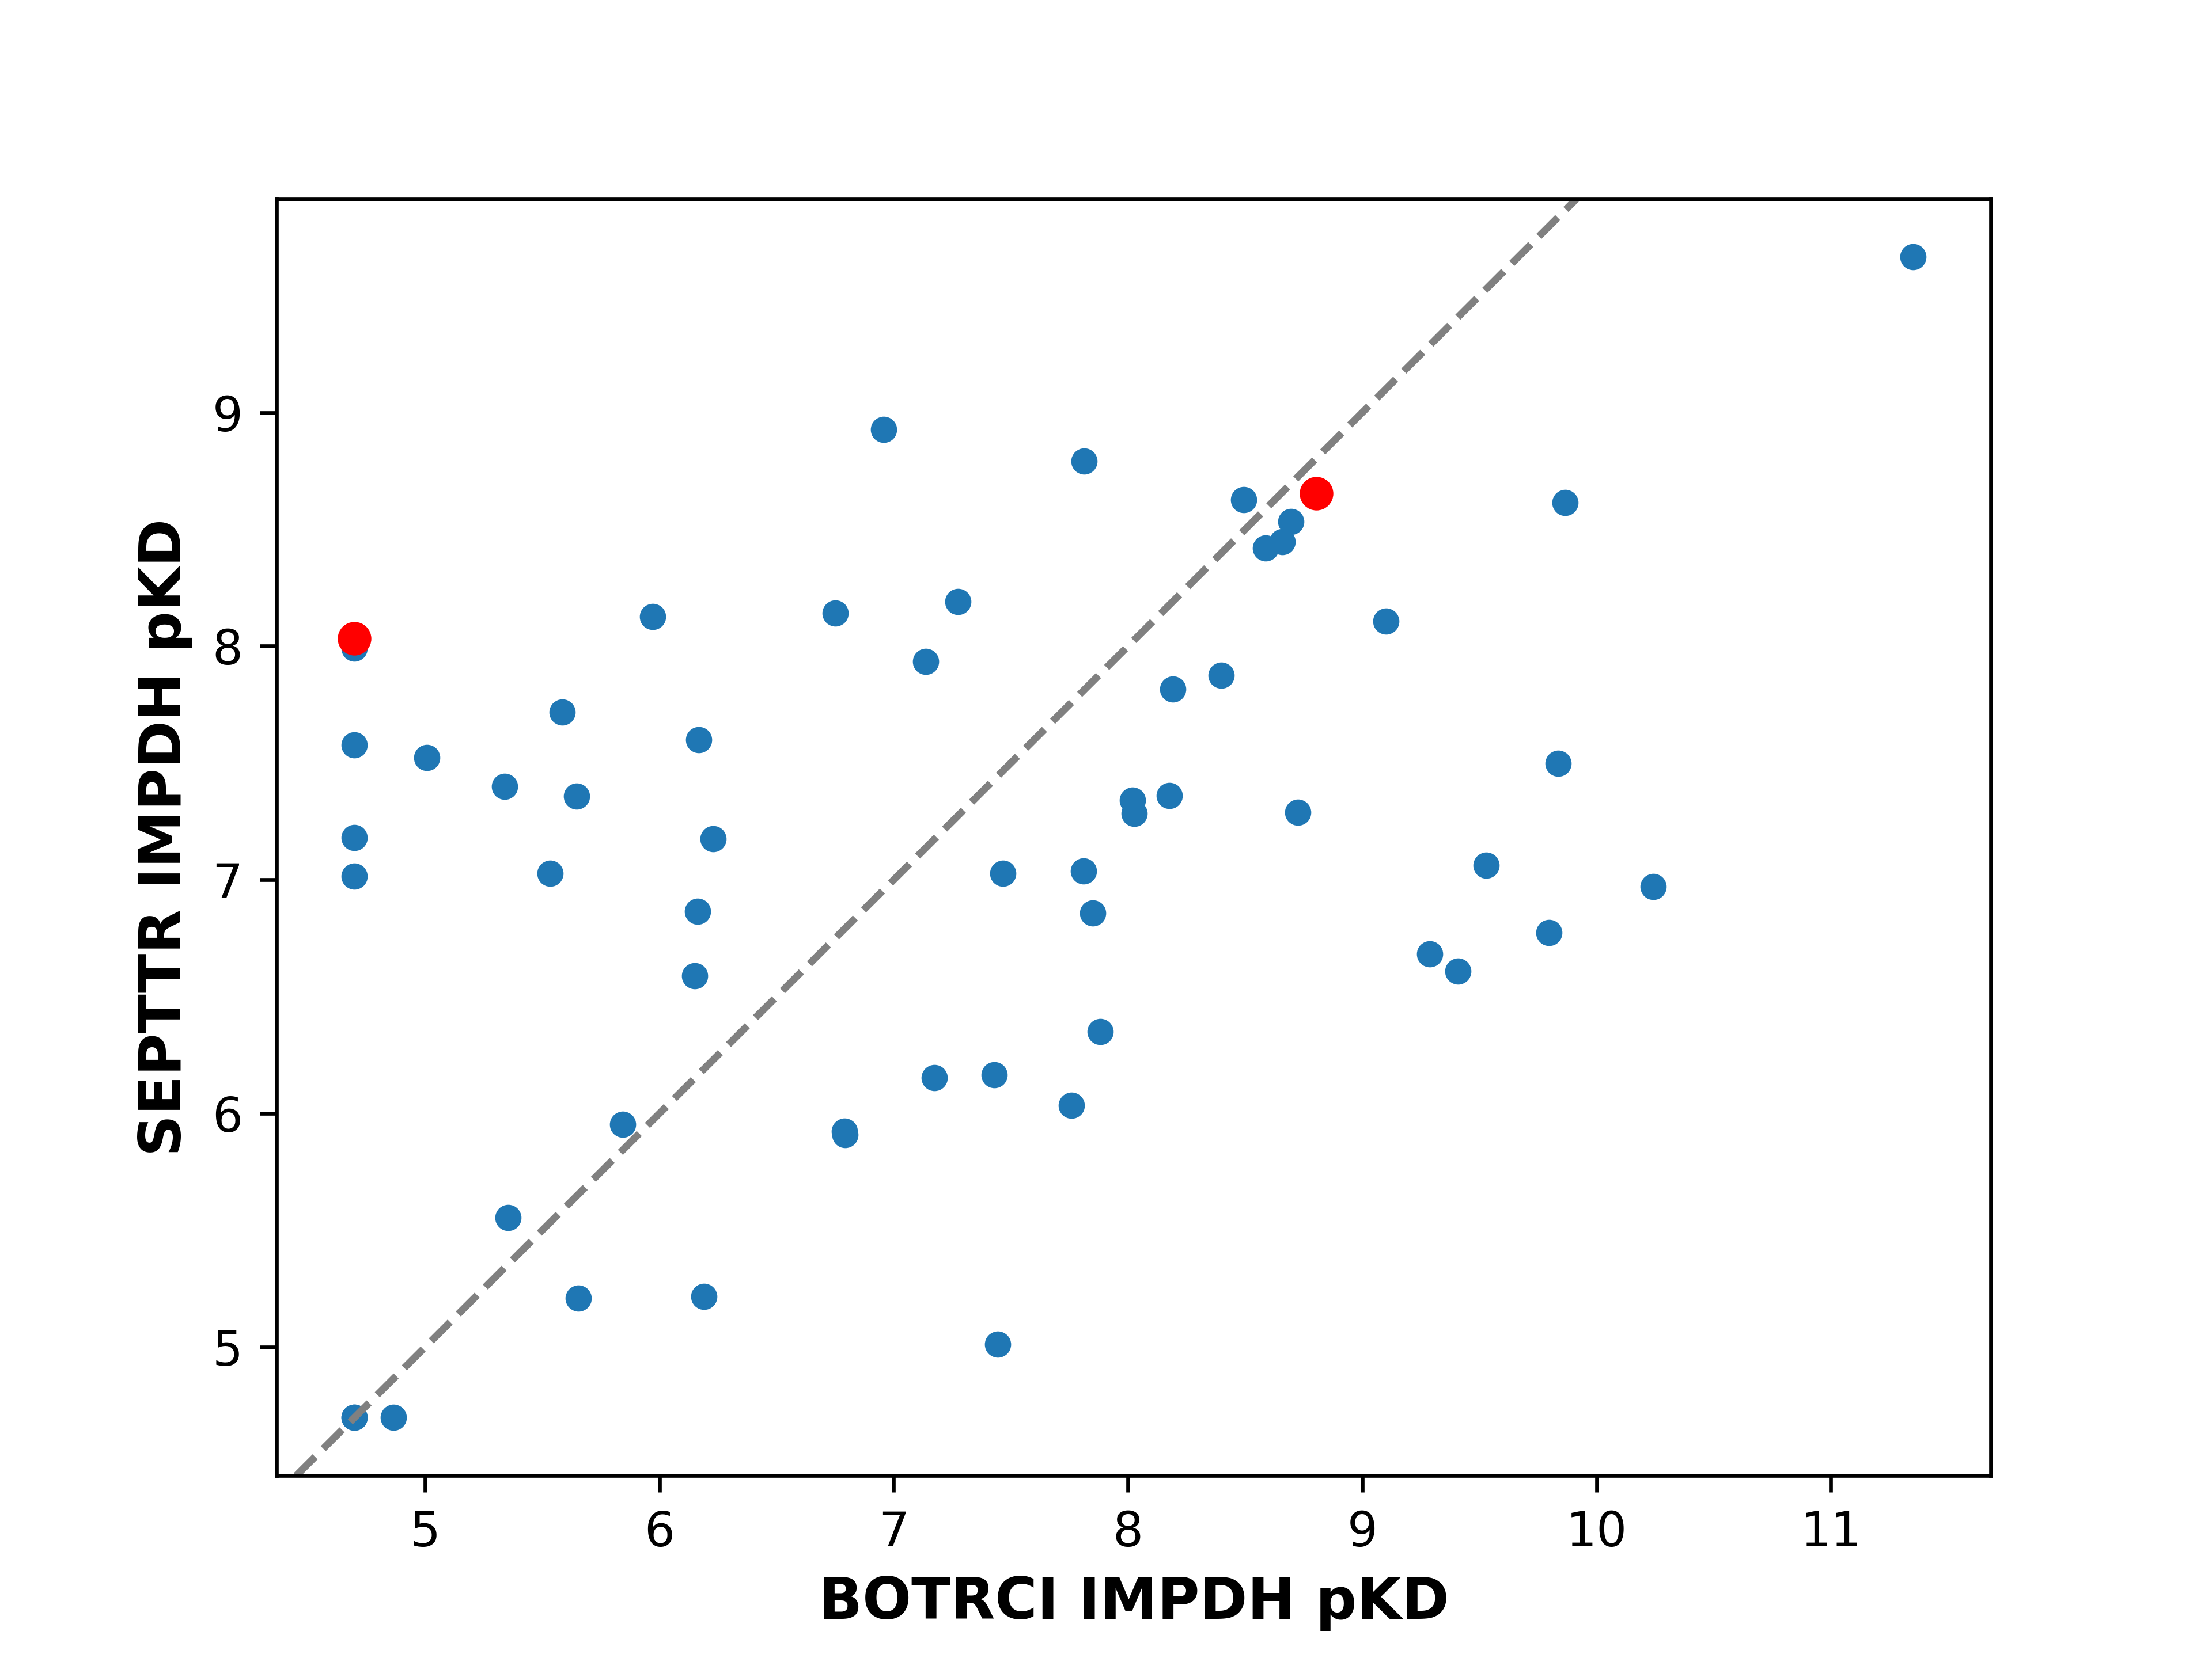
Peptides Exhibit Diverse Inhibition and Binding Affinity Profiles
Inhibition Potency: SEPTTR vs. USTIMA
Binding Affinity (SPR) SEPTTR vs. BOTRCI
BCS20
BCS20
BCS25
BCS25

Slide 9
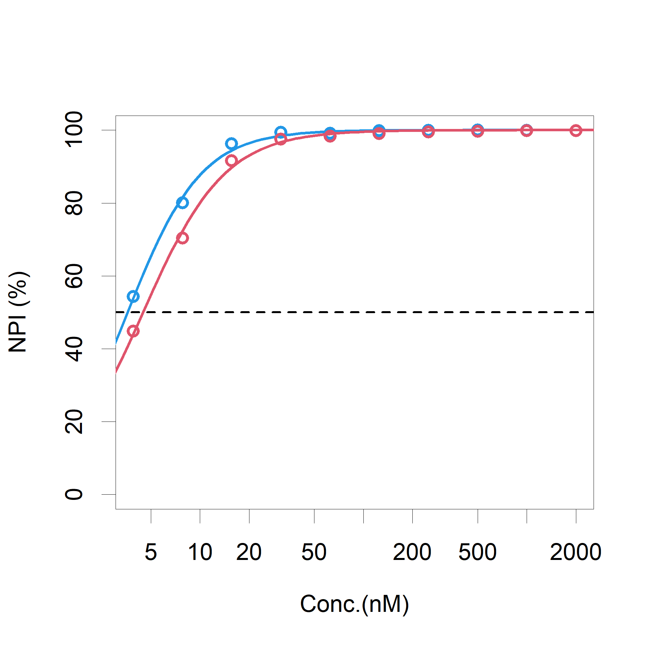
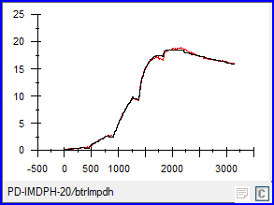
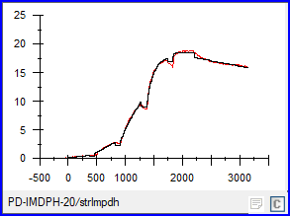
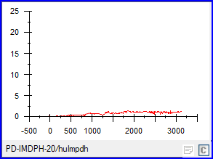
BCS20: A Highly Potent Inhibitor and Tight Binder of Fungal IMPDHs
Fungal IMPDH Inhibition by BCS20
SPR Analysis of BCS20 Binding to Fungal IMPDHs
BOTRCI
SEPTTR
 | KD (nM) | k_{a} (10⁴/M·s) | k_{d} (10⁻⁴/s)
BOTRCI | 1.6 | 8.8 | 1.4
SEPTTR | 1.4 | 8.4 | 1.1
HOMXSA | ND | ND | ND
HOMXSA
BOTRCI IC50 = 3.6 nM
SEPPTR IC50 = 4.5 nM

Slide 10

BCS20 Gains Selectivity Advantage by Spanning a Larger Epitope in the Flap Region
Homology
Flap region (sequence:439-489)
Septoria - human IMPDH1 : 62%
Septoria – human IMPDH2 : 57%
Catalytic site (within 6Å from IMP and BCS20, except flap region)
Septoria - human IMPDH1 : 89%
Septoria – human IMPDH2 : 86%
Flap region
BCS20
Blue: SEPTTR IMPDH:
BCS20 complex
Yellow: BCS20 peptide
Gray: IMPDH-1 (1JCN)
Green: IMPDH-2 (1NF7)
Pink: IMPDH-2 (1NFB)
IMP
Catalytic site
• Flap region (including disordered region) is significantly flexible and low homology.
• Catalytic site is rigid and highly conserved.
Septoria-human selectivity is supposed to be caused by the flap region.
Notes:
Resolution 2A

Slide 11
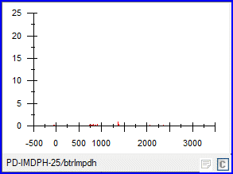
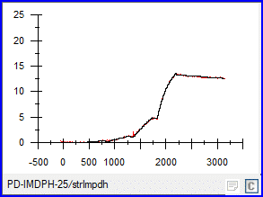
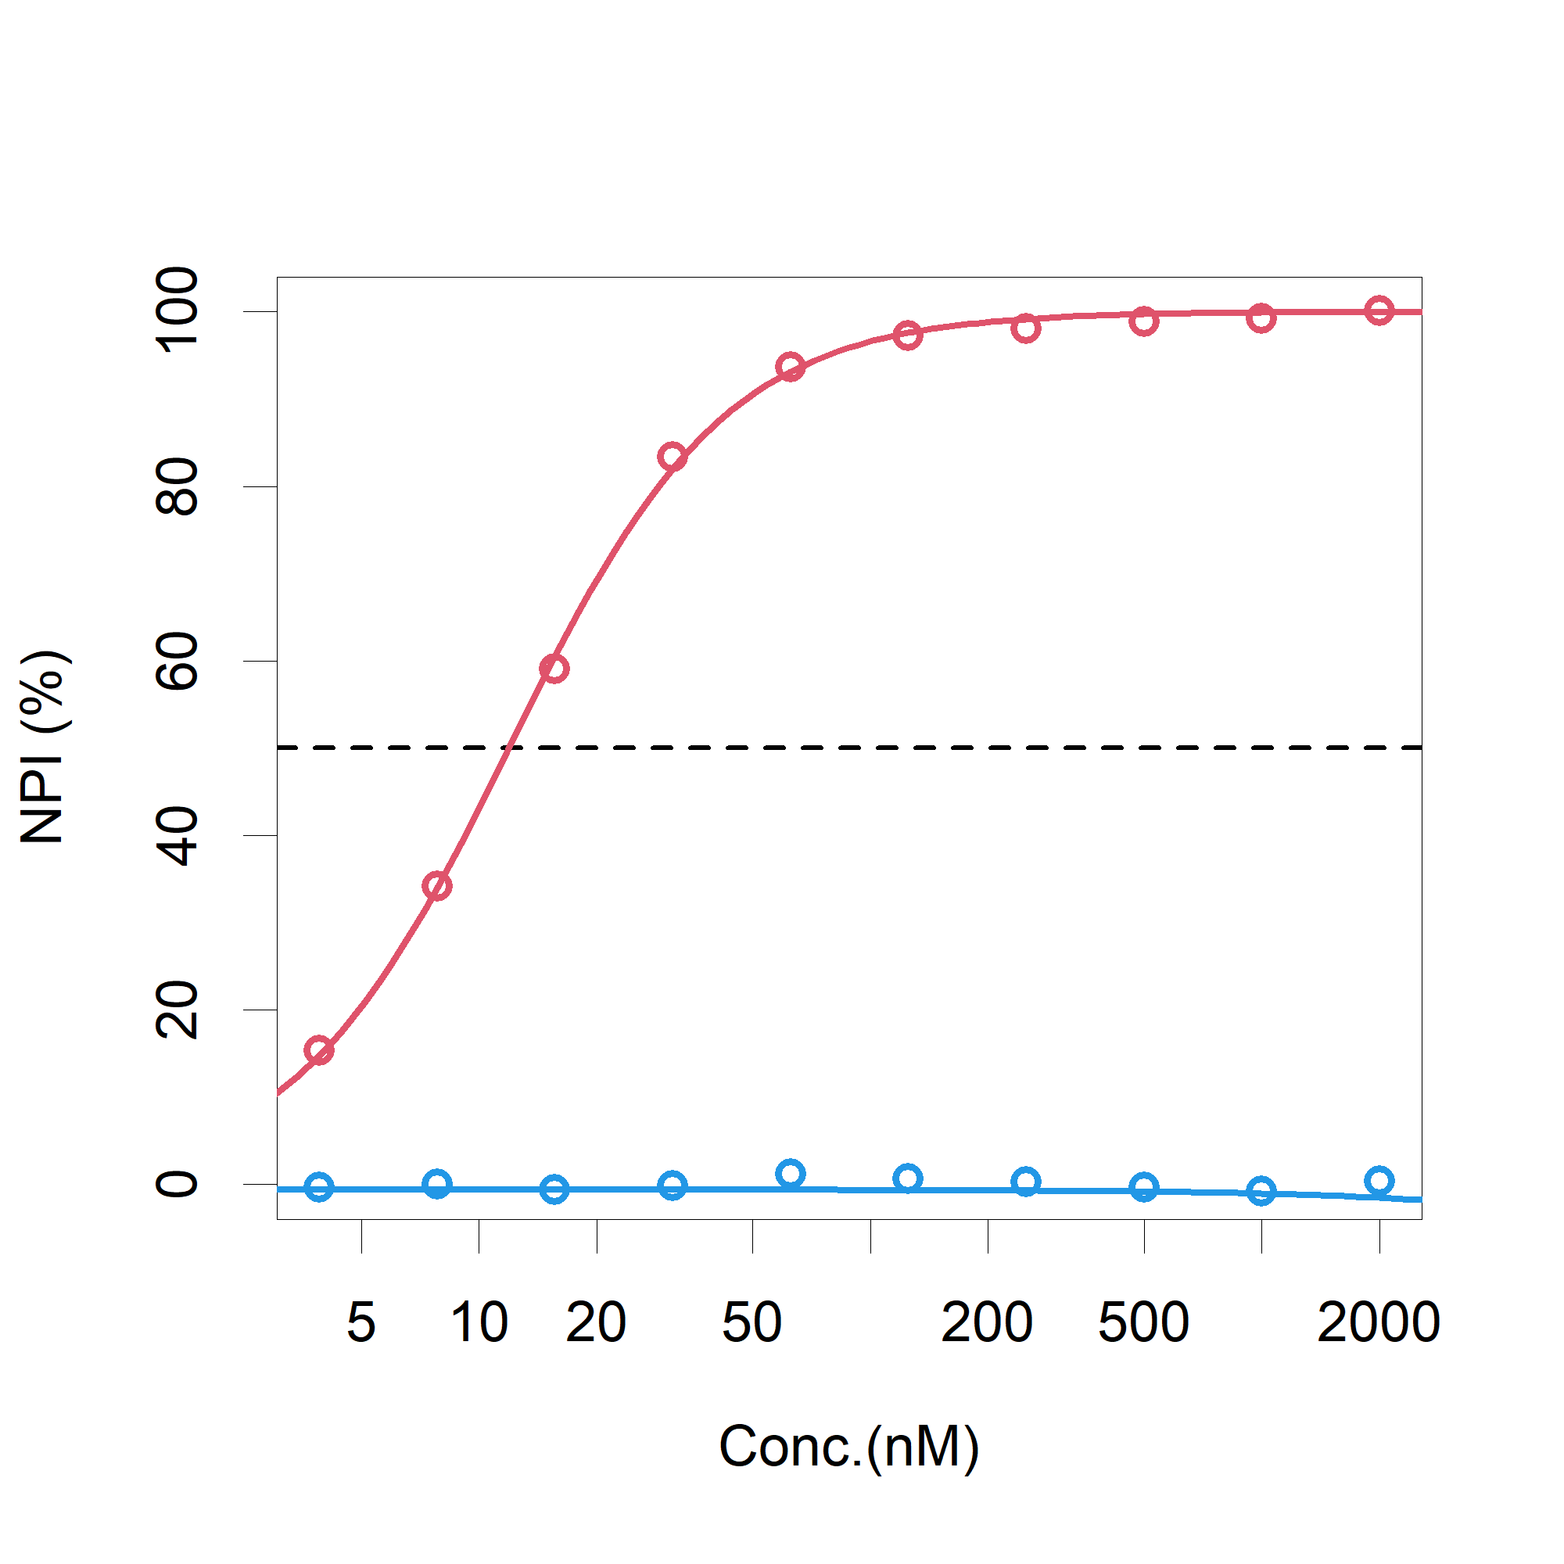
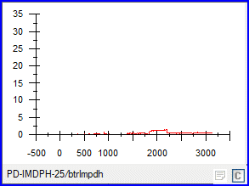
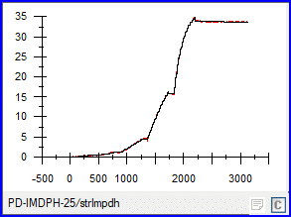
BCS25 Exhibits Selectivity Across Fungal IMPDHs
BCS25 | BOTRCI | SEPTTR
IC50 (nM) | >2000 | 12
KD (nM) | ND | 7.6
KD w/o IMP (nM) | ND | 1.9
BOTRCI
SEPTTR
+IMP
SEPPTR
BOTRCI
-IMP

Slide 12
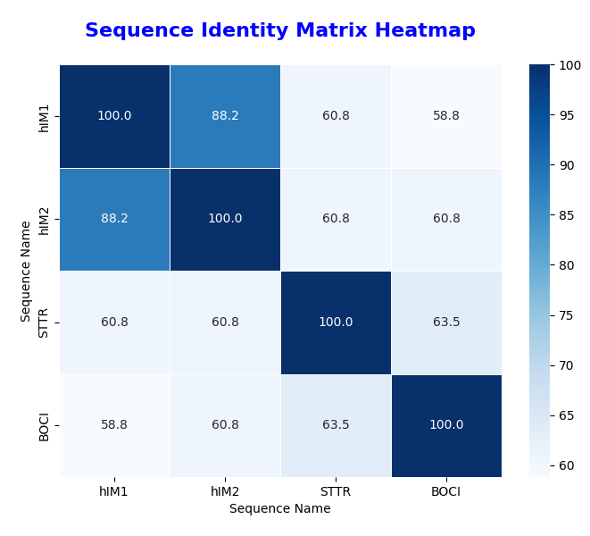
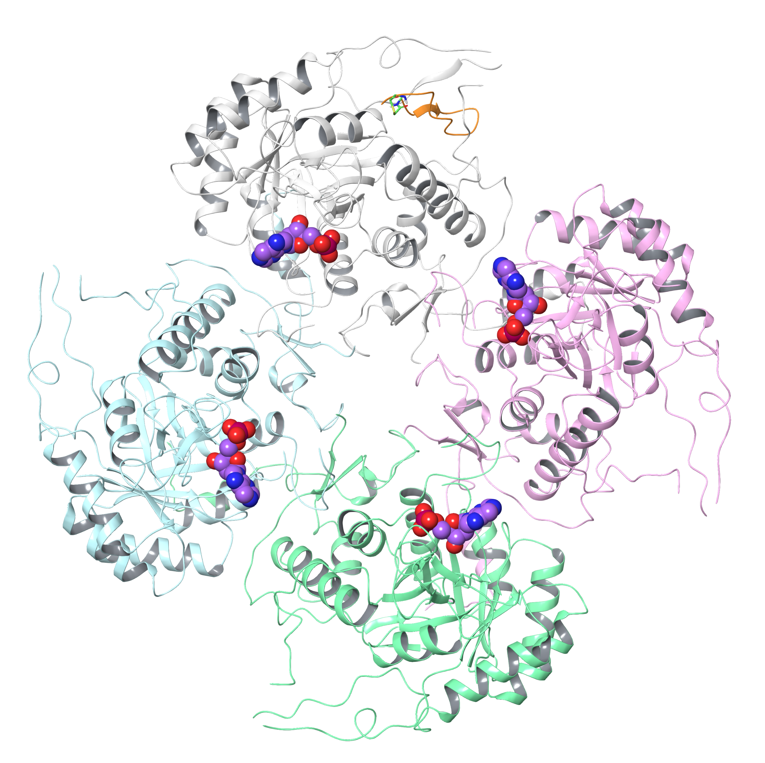
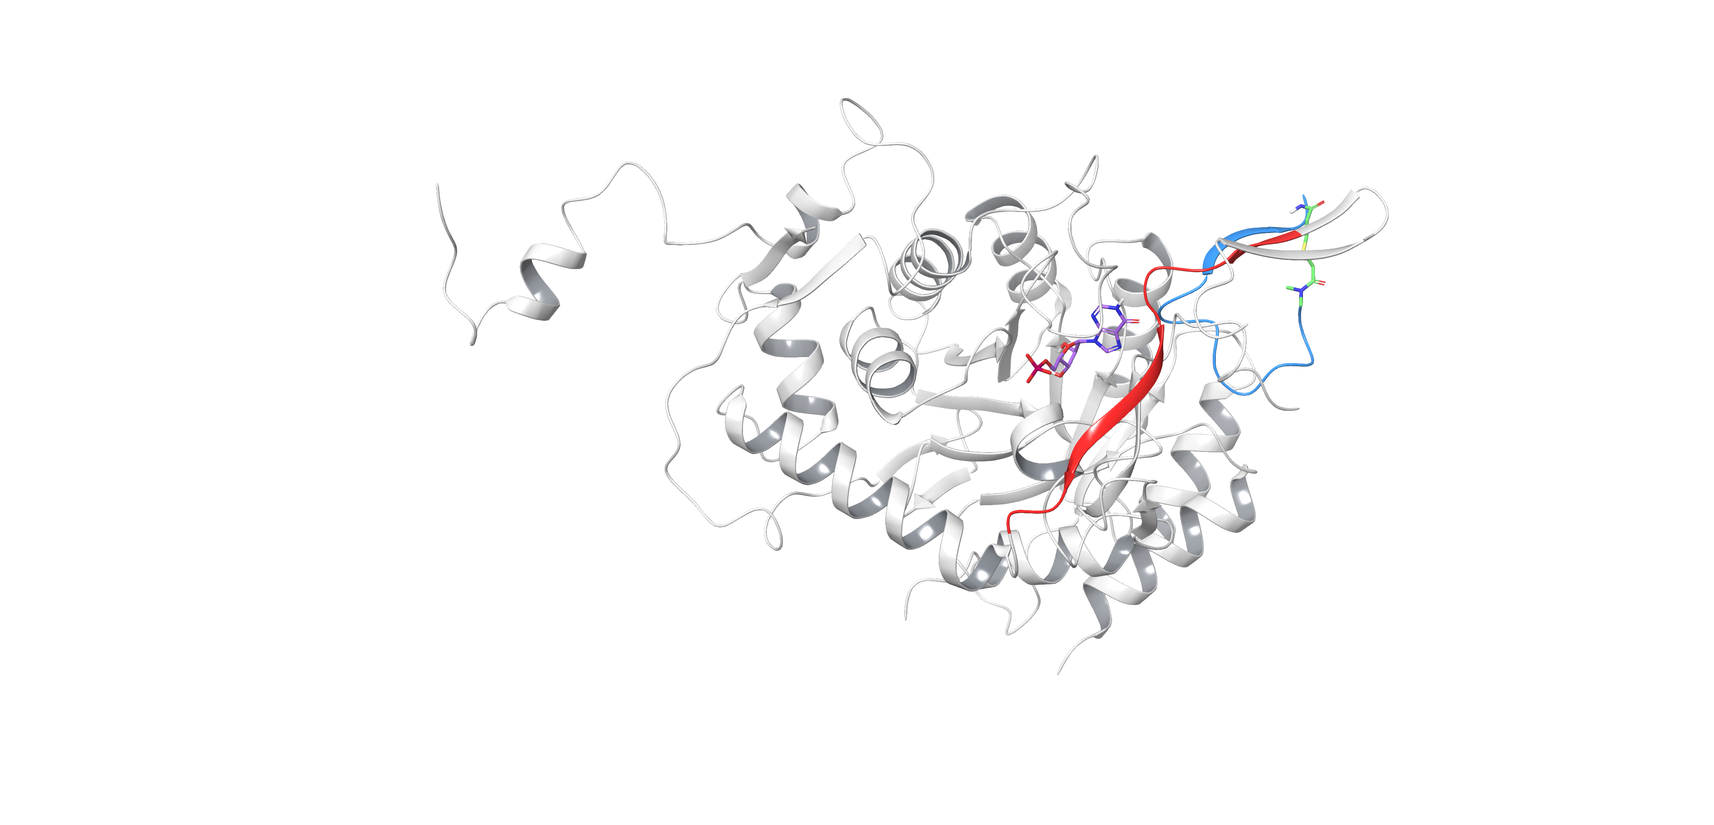
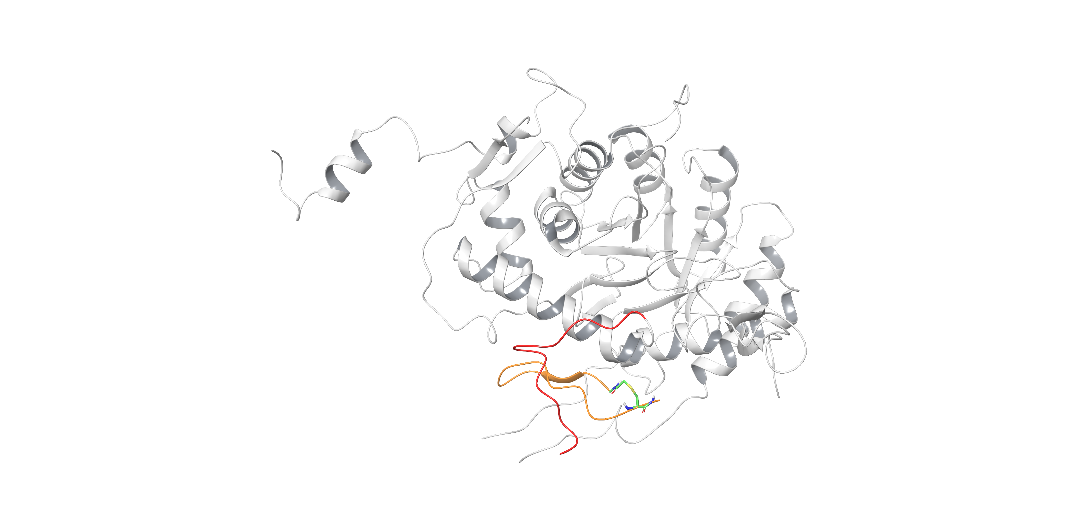
BCS25 Targets a Novel Allosteric Site on IMPDH
BCS25-IMPDH Tetramer Complex
BCS25 Binding Drives Structural Shift in L476–R488 Segment
chainA
BCS25
BCS6
IMP
IMP
IMP
L476-R488
chainC
chainD
IMP
IMP
chainB
L476-R488
BCS25 is far from IMP pockets of another chains (IMPs were transferred from 1JCN tetramer)
BCS25

Slide 13
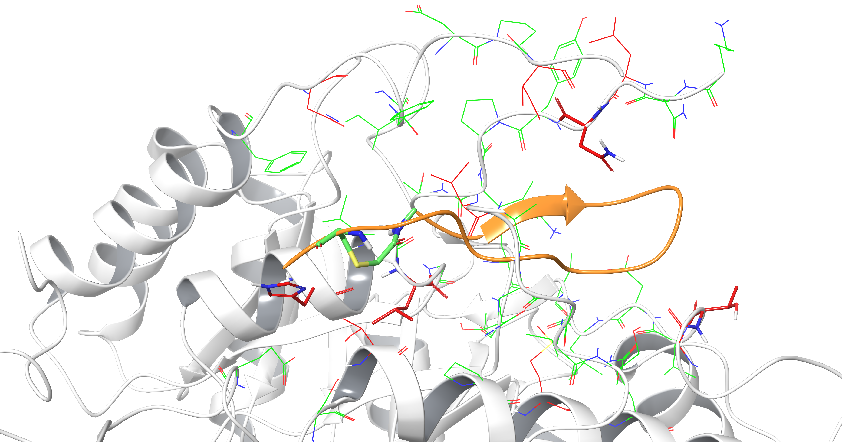
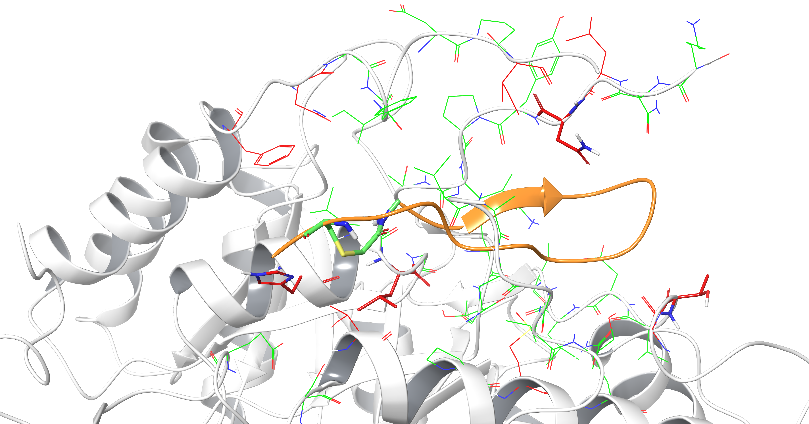
Sequence Differences Reveal the Basis of BCS25 Selectivity
Sequence Comparison with hIMPDH1
Mutated, Conserved residues
Sequence Comparison with hIMPDH2
Mutated, Conserved residues
BCS25
BCS25
Similarity (within 4.5Å from BCS25):
Septoria - human IMPDH1: 59%, 71%
Septoria - human IMPDH2: 58%, 71%
* Red tube (thick) residues contributes to interaction with BCS25
from FMO calculation result
Notes:
Within 10A around the dummy atoms, Septoria: human1 61%, Septoria :human2 61%, septoria:botrytis 63%.

Slide 14
Key Open questions:
Can these peptides be optimized to enhance bioactivity & align with agrochemical properties—such as molecular weight, solubility, and stability?
Are novel allosteric or non-canonical binding sites accessible to alternative small-molecule modalities beyond traditional approaches?
Can advanced formulation technologies improve peptide delivery, uptake, and overall field performance?
Are there alternative targets with fewer intrinsic challenges (such as extracellular localization) that may offer more tractable development paths?

Slide 15
Summary
Bayer actively partners with leading academic institutions and industry innovators worldwide to deliver next-generation crop-protection solutions, advancing the CropKey mission.
The Bayer–PeptiDream collaboration successfully identified potent and selective peptides targeting IMPDH—a challenging enzyme due to its highly conserved active site shared between fungal and human homologs, which limits the safety profile of conventional small-molecule approaches.
Among these, peptide BCS25 binds to a novel allosteric site, offering unique mechanistic insights that pave the way for more precise and effective crop-protection strategies.

Slide 16

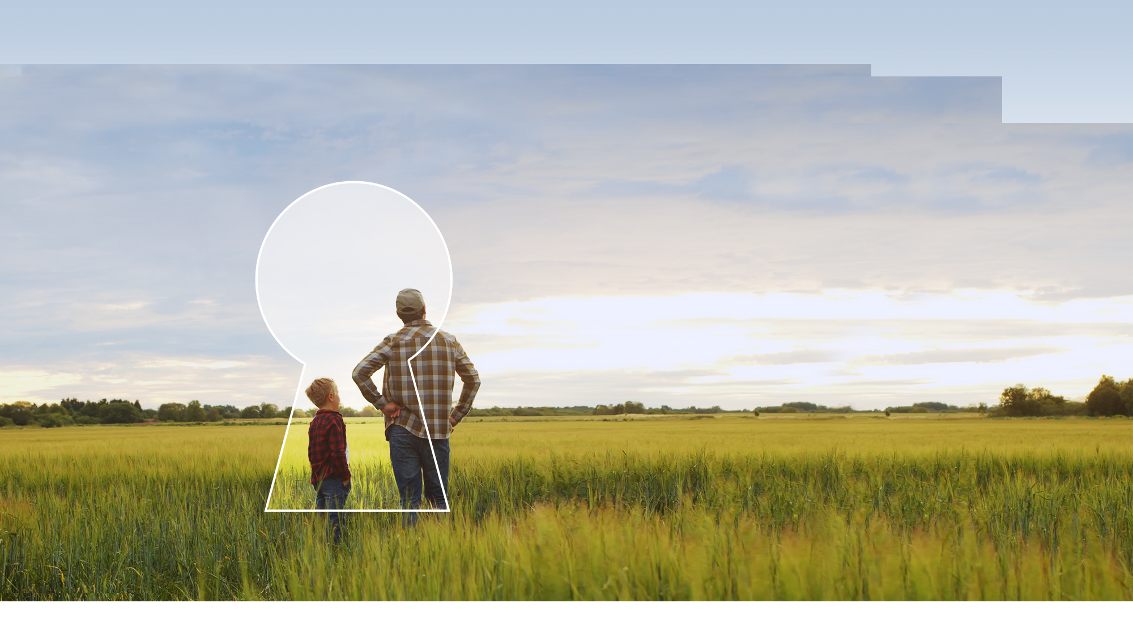









Pioneering Together: Unlocking Tomorrow’s Crop Protection Solutions
Differentiation
Social license to operate
Sustainability
+
+
+
+
+
+
CP R&D unrivalled Experience
Computational Target Discovery
Phenotyping and mechanistic biology
Predictive early human & environ. safety
Computational Life Sciences
Partner of choice
Scientists courageous to pioneer
Notes:
Option A
Bayer is the market leader in crop protection – a position earned through more than 100 years of experience
The overall R&D investment in 2022 was 2.6 billion euros before special items which advances our pipeline with an estimated peak sales potential of more than 30 billion euros, half of which are incremental to the existing base
Bayer Crop Science’s innovation platforms – (breeding, biotechnology, chemistry, biologicals and data science) are bringing together the recent advances in biology, chemistry and data-science. This convergence is driving breakthrough innovation and allowing us to generate system solutions
Human and environmental safety experience: we have unique expertise in early testing of key aspects in human and environmental safety in vitro, and develop models to predict safety aspects when designing a molecule.
Bayer Crop Protection business has established markets, earnt brand recognition and loyalty from our customers making us the partner of choice
Finally, all of this is possible thanks to our outstanding team of pioneering scientists – passionate to design the best solutions to farmers, consumers and the planet and unlock answers to some of agriculture’s most pressing challenges.

